Slide 1
TASMU TEST GUIDELINES
Part 1
Owner TASMU Quality Control Team
January 2022

Slide 2
AGENDA
1
TASMU TEST METHODOLOGY
2
TASMU TEST STRATEGY
3
TASMU TEST FRAMEWORK

Slide 3
TASMU TEST METHODOLOGY

Slide 4
TASMU TEST METHODOLOGY : Testing Principles
1
1. Early Testing
2. Software Testing Helps Identify Bugs
3. Exhaustive testing isn’t possible
4. Defects Clustering
5. Pesticide Paradox
6. Testing Depends on Context
7. Absence of Error Fallacy

Slide 5
TASMU TEST METHODOLOGY: Following Best Practices
1
Description
Mode of Testing
Outcome
Frequency
Environment
Functional Testing
Feature Testing
Integration Testing
E2E testing
Sanity Testing
Manual
Automated
Test Suite execution under ADO
During Release
Dev
Test
UAT
Pre-PROD
Non-Functional Testing
Compatibility Testing
Localization Testing
UI Testing
Performance Testing Note: Security Testing, Accessibility Testing and Usability testing will be managed by External Teams.
Manual
Automated
Test Suite execution under ADO
Separate reporting for performance
During Release
Dev
Test
UAT
Pre-PROD
Test Techniques
Black Box testing
Boundaries values Testing
Positive Test
Negative Test
Checklist based tests
Manual
Automated
Test Suite execution under ADO
During Release
Environment wise
Notes:
In summary, our methodology includes functional and non functional testing and several testing techniques and follows the best practices, now let is do a close up and understand how this is organized and managed by exploring the Tasmu Test Strategy.

Slide 6
TASMU TEST STRATEGY

Slide 7
TASMU TEST STRATEGY: Process of Testing
2
Review of the US and Acceptance Criteria during grooming sessions
1. In scope US review and understanding
For each Release, listed testing activities are executed and repeated during the testing phase
Prepare the Release test cases and Test Data
2. Release Test Plan preparation
Full Regression Testing
3. Regression Testing
Enhancements and fixes testing
4. Release Testing
Sanity checks
5. Sanity testing
Push Release to Live environment
6. Go-Live
Notes:
These activities are following this Release timeline (and you move to next slide)which is a sample of a release progress timeline

Slide 8
2
TASMU TEST STRATEGY : Release Timeline Sample
Month
W1
Sun
W2
Mon
Tue
Wed
Thu
W3
Sun
Mon
Tue
Wed
Thu
Sun
Mon
Tue
Wed
Thu
W4
Sun
Mon
Tue
Wed
Thu
Execution Timeline
1&2.Test Preparation
3.Regression Testing
4.Release X Testing
5.Sanity Testing
Rx Live
6.Prod Deploy
Activity | Release X Activities | Tested vs Total | Progress Rate
Release X Testing | Functional Testing | xx | 100%
 | Bugs backlog Testing | xx | 100%
 | Issues backlog Testing | xx | 100%
 | Overall Testing | XX | 100%
NB:The testing effort and timelines will be changing based on backlog & scope of requirements.
On Track
Delayed
Off Track

Slide 9
2
TASMU TEST STRATEGY: MSI-Testing Activities
Test Phases
Key Activities
Deliverables
Environment
Responsibility
Quality Check & Review (PM/QC)
Planning
Understand the scope and review User Stories during sprint planning – Dev/Test
Determine the time of test estimation during sprint
Set the sprint time schedule of testing activities
Test Plan
Test
QC Team
Design Functional test cases against acceptance criteria using standard templates
Prepare test data​ on the test environment
Share Functional test cases with development team to validate code in Dev environment
Functional Test Cases
Test
QC Team
Preparation and Design
(QC Team)
Preparation and Design
(Dev Team)
Design Technical test cases against acceptance criteria using standard templates
Prepare test data​ on the test/dev environments
Technical Test Cases
Dev/Test
Dev Team​
Execution in Dev
Validate code in Dev environment against acceptance criteria by executing Unit, Functional, and Technical test cases
Validate integration points with other parties.
Update the status of user story from 'Under Development' to 'Dev Complete'
Test Execution Report (Unit, Technical, and Functional Test)
Defect Report
Dev
Dev Team​
Execution in Test
Validate code in Test environment against acceptance criteria by executing Technical test cases – Dev team.
Validate code in Test environment against acceptance criteria by executing Functional test cases – QC team.
Update the status of user story from 'Dev Complete' to 'Test Complete’ – Dev Team
Test Execution Report
Defect Report
Test
Dev/QC Teams
Notes:
During that time slot dedicated to a release, different activities will happen on different levels and between different team members. Starting from the planning……then explain the table
Then: all these activities are centered around a specific scope of Testing which will be mainly around 2 components: B2B and B2C and then move to the next slide

Slide 10
TEST STRATEGY: Scope of Testing
2
B2B/B2C
CRM
ITSM
Developer Portal
ODP
Billing
CMS
B2B Portal – UI of the system for End Users.
B2C - B2C Web Portal and App as digital interface.
Developer Portal – B2B Providers can view the API related information from Developer Portal, to integrate with their own Use Cases.
Billing – Billing systems is responsible to keep record of all transaction and manage invoices, Orders etc. of the user
CMS – Content Management system is responsible for contents like News, Hero web, Media, Sector based info etc.
CRM – Customer Info data base, and Interface to resolve Service request, support request etc.
ITSM – The ITSM application, is an advanced, solution that unifies key applications across Service Management, Asset Management, and IT Operations Management into one application.
ODP – Open Data Portal will give some public information and insights to people who wants to analyse data.
Notes:
The rest of the components is tested as part of the regression test.If any new requirement will be committed to the release then new test cases will be prepared and executed for that component.
This scope is tested following different test plans based on different environments.

Slide 11
TASMU TEST STRATEGY : Test Plan
2
UAT Environment
Release Verification Tests
Manual Sanity Regression Tests
New Scope
Automated Regression
Pre-PROD Environment
New scope Testing
New Scope
Manual Regression Tests
Test Environment
E2E Product Testing
Rest of backlog
Resolved Bugs
Resolved Issues
Note: Performance testing will be performed on Pre-prod every 6 months or as per need.
At the end of the test plan preparation phase, QC team will send a Test execution Plan which explains the execution phase details.
Notes:
Transition sentence: To sum up, our Test Strategy follows a pretty standard process of testing which distributes activities & tasks between different team members, within a pre-defined scope and through different environments. So the question now is, how do we follow this strategy and how de we apply that process, which framework is helping us getting this in motion and which tooling keeps us close to the guidelines. For that we would like to present the following framework….

Slide 12
TASMU TEST FRAMEWORK

Slide 13
3
TASMU TEST FRAMEWORK : Key Roles & Responsibilities
Key roles and responsibilities of Team members who will support the Testing Stages:
Role | Responsibility
Release management | Planning Release lifecycle Managing Risk for Release scope Communicate all key messages and plans Keep traceability of all changes in requirements Monitor progress and ensure delivery within time
Scrum Master | Tracks all Release activities and resources, ensuring Release remains within scope. Facilitates identifying and bringing closure to open issues. Takes responsibility for Release status, risk management, priorities, and communication to executive management.
Development Leads | Define approach and targets for, Unit testing and Code review. Define approach and targets for, Technical testing and execution plan. Review and approve the Pull Requests for code merging with Master branch, confirm the Feature branches are removed properly. Coordinate with DevOps team to move the builds to higher environments Make sure the builds provided to the test team fulfil with entry criteria. Participate in the reviews of quality risks and participate in defect triage meetings. Coordinate for assigning and correction of defects found in testing.
Test Leads | Create and maintain the Test Strategies/Test Plan. Supervise the execution for types of testing by testers, report around the progress towards acceptance criteria, and provide relevant test metrics. Communicate defects found in the testing, supervise test cases management/defect management and participate in defect triage meetings. Conduct End-to-End SIT testing and assure delivered solutions are met requirements and expectations. Verify and accept the test deliverables within the testing scope. Work closely with testing teams and developers to resolve and/or retest defects.
Developers | Develop Unit and Integration Tests related to the code he delivers. Ensure that the code committed to a shared branch does not break the build and passes unit and integration testing. Analyze and fix defects considering all quality assurance best practices. Perform internal peer review and unit test of defect fixing. Assist testers in testing and participate in test data preparation.
Testers (Functional/Non Functional) | Write detailed test cases for each test activity and complete traceability to requirements. Execute the test cases for each type of testing based on related scope. Identify and log defects, provide supporting information, and validate the fix once it is available. Cooperate with developers on reproducing defects and their analysis.
NB: Our A1QA team owning the Automation and performance test activities is part of the QC team but located in Europe.
The Business team is providing the requirements and building the back log of US is part of OO/MCIT.
Notes:
Our framework consists first in a clear distribution of roles and definition of tasks between team members.We have the Release management then the scrum master etc… we will let you go through the list offline.Now 2 notes we would like to add in this regard, Our A1QA team …….we have also in place a defect management process using Azure Dev Ops tool, …

Slide 14
3
TASMU TEST FRAMEWORK : Defect Management
MSI QC Test Team retests the fixed defect and actions as :
“Closed” status if successful “Active” status if failed retest
Assign defect back to Developer and add tag as “ReassignedFailed”
Defect is logged unto ADO by MSI QC Team Tester:​
Defect status “New”​
Assign it to Developer and add tag with “Sprint <number> “​
Severity | Description | Characteristics
S1 | Critical | Application unavailable.
S2 | High | Major functionality impacted and work around not obvious
S3 | Medium | Medium functionality impacted and work around exists
S4 | Low | Cosmetic defect
5
1
Review existing “Active” defects to :
'Resolved ' if fix is ready and assign it Back to MSI QC Test Team for test
'Deferred': if Defect will be fixed in a later release and add tag “Deferred”
Triage Call
Developer will try to replicate it and Bug will be discussed during Triage call
4
2
Priority | Description | Characteristics
P1 | Frequent | Occurs too often and can impede business process efficiency
P2 | Possible | Occurs often enough that the process is impacted in production.
P3 | Unlikely | Occurs in some cases and usually has a work around.
P4 | Rare | Occurs rarely in some edge business cases
3
Review “New” defects to:
“Removed” if invalid
“Active” if valid and update severity/priority if needed and add Tag “Triaged”
Triage
(prep and meeting)
Notes:
This process is followed during Triage calls and will take place during execution phase.Once this phase is completed on each environment, there is an approval step needed to move to the next environment:

Slide 15
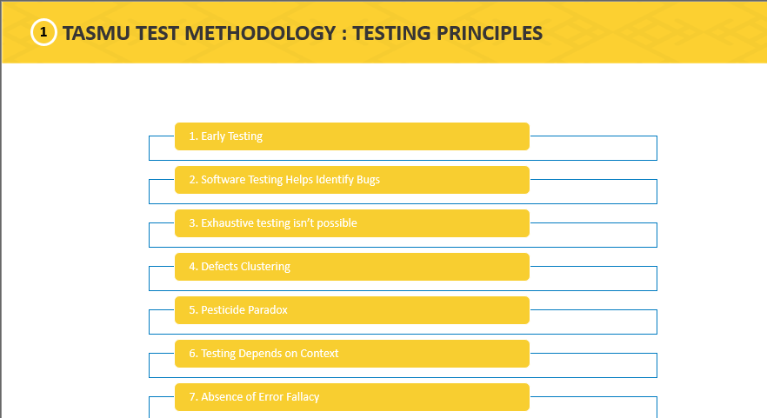
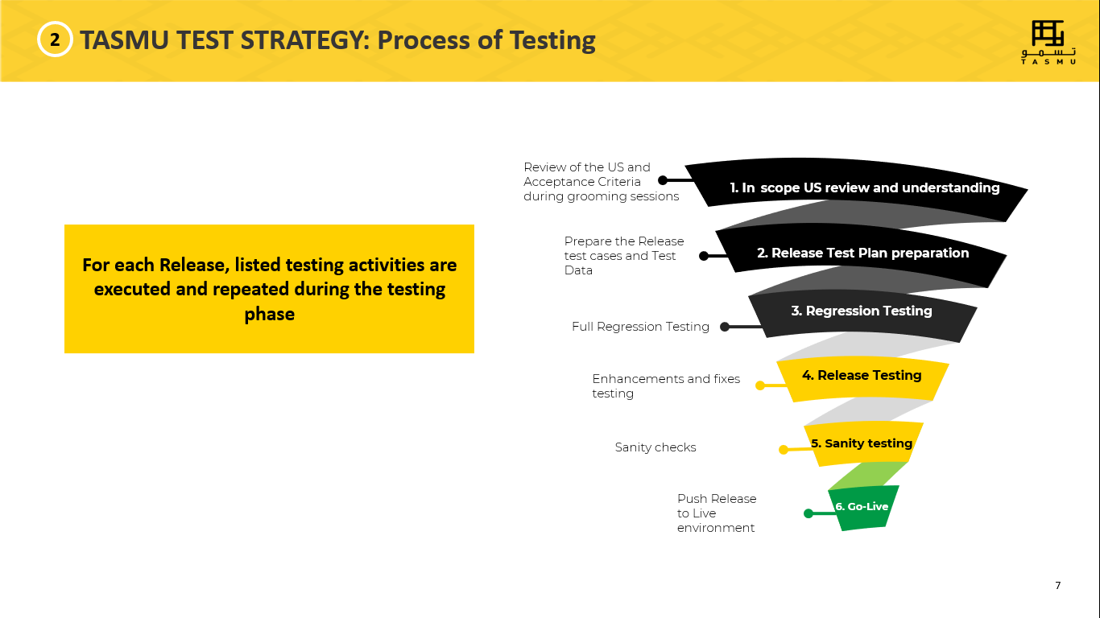
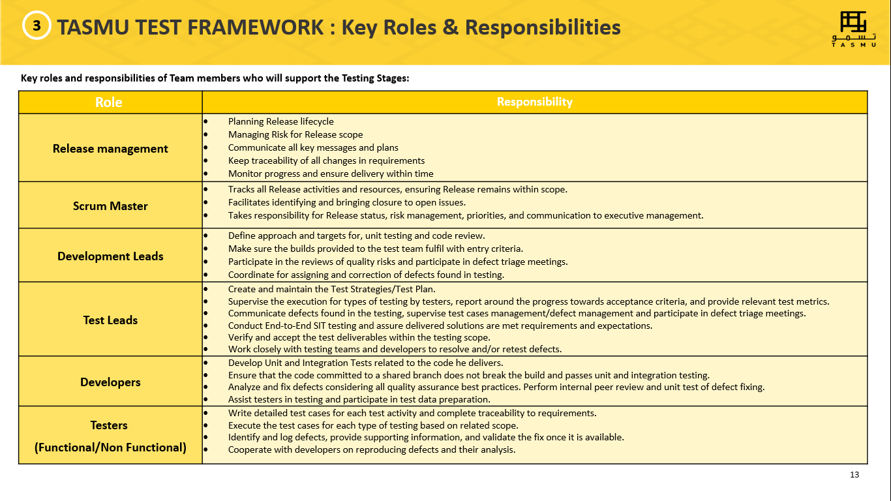
SUMMARY
Test Methodology
Testing Strategy
Test Framework
Notes:
In summary, we have presented to you our Methodoly or let’s say state of mind toward the TASMU Testing , then we described the adopted strategy and the framework that helps applying those guidelines. Now we will move to the practical side of things with the description on ADO of how we do this step by step and we will need please more focus from your side here.

Slide 16
Thank you for being part of the TASMU journey
Notes:
For the

Slide 17
Questions ?

